Slide 1
Image Segmentation
Books : Szelisky (2010)
Forsyth, Ponce (2011)

Slide 2
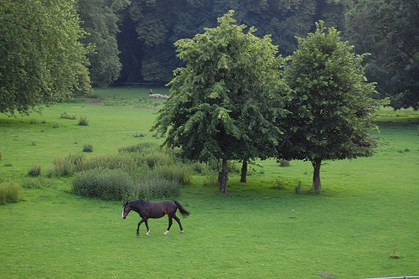
What is segmentation ?
Foreground vs background segmentation?
Grouping pixels according to some similarity criteria (color, texture, motion depth)?

Slide 3
What is segmentation
Segmentation into meaningful quantities (objects) requires both bottom up and top-down processing (high level knowledge)
Psychology: Single image segmentation is possible because human have learnt from 3D cues how to extract objects
Vision Scientists have various theories about how interpretation happens:
Gestalt theory : Grouping is the key to understanding, to extract foreground from background certain grouping mechanisms (proximity, similarity, symmetry, continuitiy, familarity, parallelity, convexity…)
Helmholtz: Unconscious Inference (3D interpretation because of hidden assumptions about the 3D world)
Structuralism: Sensory atoms are associated in memory through repeated prior joint occurences

Slide 4
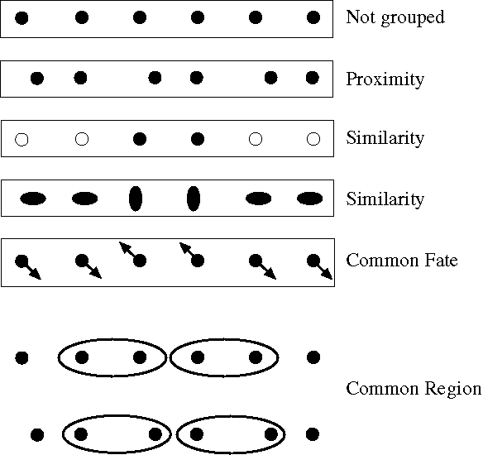
Biological:
For humans at least, Gestalt psychology identifies several properties that result
In grouping/segmentation:
Notes:
Some criteria that tend to cause tokens to be grouped.

Slide 5
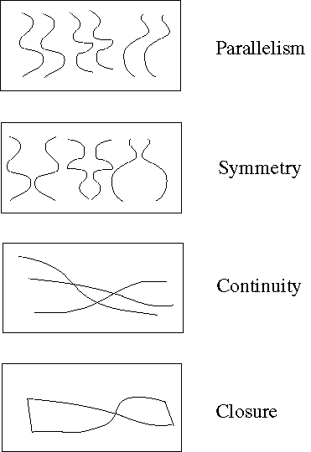
Biological:
For humans at least, Gestalt psychology identifies several properties that result
In grouping/segmentation:
Notes:
More such

Slide 6
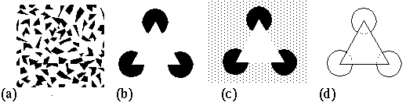
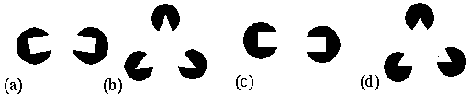
Consequence: Groupings by Invisible Completions
Stressing the invisible groupings:
* Images from Steve Lehar’s Gestalt papers: http://cns-alumni.bu.edu/pub/slehar/Lehar.html

Slide 7
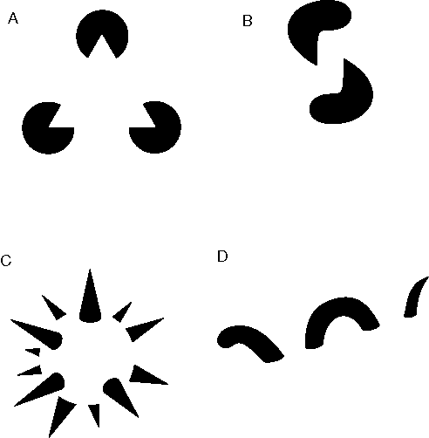
Consequence: Groupings by Invisible Completions
* Images from Steve Lehar’s Gestalt papers: http://cns-alumni.bu.edu/pub/slehar/Lehar.html

Slide 8
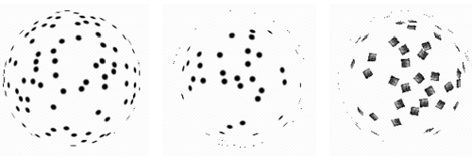
Here, the 3D nature of grouping is apparent:
Why do these tokens belong together?
Corners and creases in 3D, length is interpreted differently:
Notes:
A disturbing possibility is that they all lie on a sphere -- but then, if we didn’t know that the tokens belonged together,
where did the sphere come from?

Slide 9
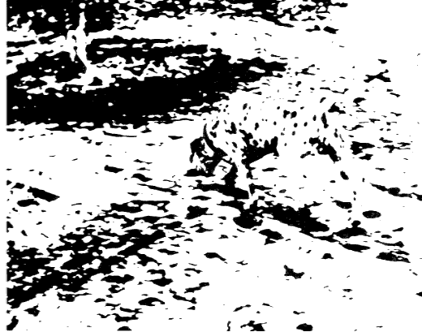
What do you see?
dog eating under a tree

Slide 10
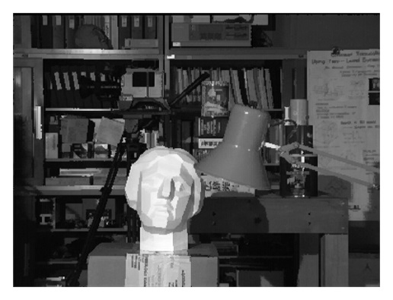
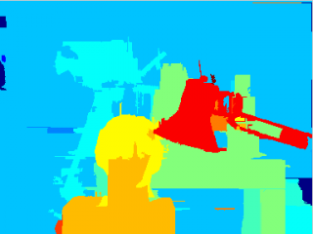
Segmentation for Robotics
Depth cues from motion, stereo
Depth cues from 3D measurements
Segmentation into surfaces
Tsukuba image from Middlebury Stereo page

Slide 11
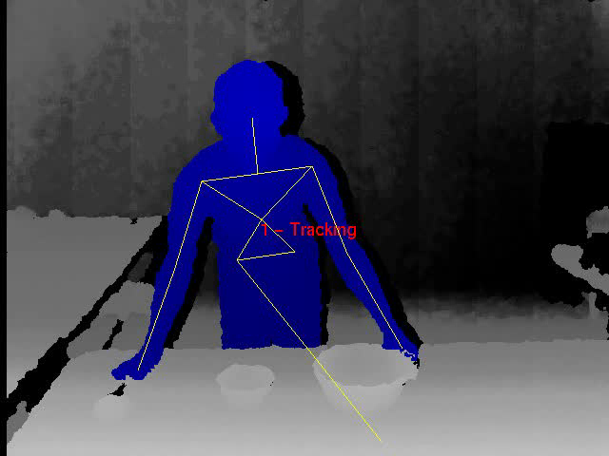
Human tracking from Kinect

Slide 12
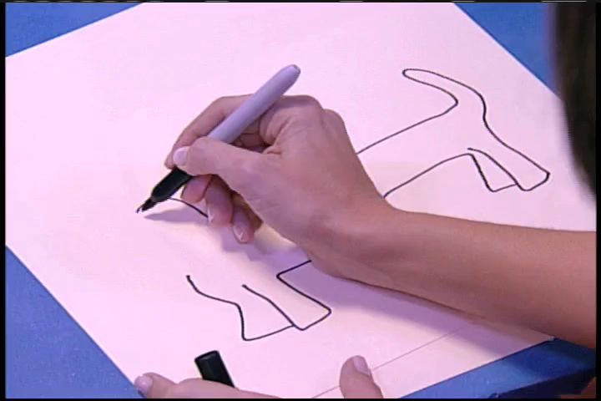

Hand segmentation from motion and color
C L. Teo and C. Fermüller, JHU CLSP Workshop 2010

Slide 13
A set of techniques
Clustering:
Split and Merge
K-means
Graph-theoretic Clustering
Mean shift and mode finding
Energy minimization on MRFs: graphcut
Energy minimzation: Variational methods
Snakes
Level Sets

Slide 14
Clustering
Domain spaces
spatial domain (row-column (rc) space)
histogram spaces
color space
texture space
other complex feature space
depth values
Image motion

Slide 15
Split and Merge
Simplest: Set threshold ->binarize, morphological operations, compute connected components: Single threshold usually not sufficient
Divisive Clustering: recursively splitting the image
Agglomerative Clustering: recursively merging regions

Slide 16
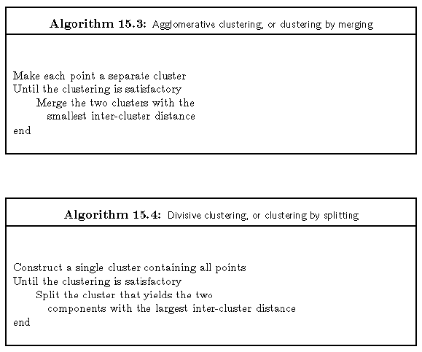
Simple clustering algorithms

Slide 17
Issues
What is a good inter-cluster distance?
Point-Cluster distance
single-link clustering: distance between closets elements -> extended clusters
complete-link clustering: maximum distance between element in 1st cluster and element in 2nd cluster -> rounded clusters
group-average clustering: average distance between elements in cluster -> rounded clusters
How many clusters?
Dendrograms
yield a picture of output as clustering process continues

Slide 18
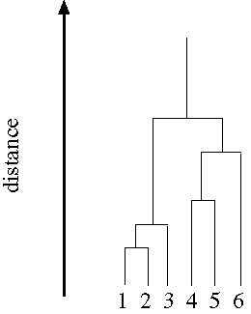
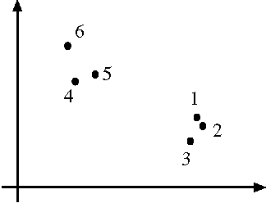
data set
Dendogram obtained by agglomerative clustering using single-link clustering

Slide 19
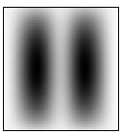
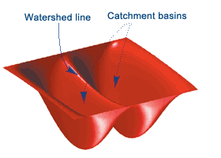
Watershed Algorithm
Thinking of an image as a surface. For example this image
With surfaces, think of the technique in terms of
watershed lines separating catchment basements,
which are regions where water would flow into the
same lake .
Idea: Flood the landscape at local minima and label ridges wherever differently evolving components meet
Implemented using a priority queue of pixels and breadth-first search (Vincent and Soille 1991).
Often applied to smoothed gradient image

Slide 20
im = imread('DSCN0984.jpg');
im = imresize(im, 0.2);
imgray = rgb2gray(im);
L = watershed(imgray);
rgb = label2rgb(L,'jet',[.5 .5 .5]);
figure, imshow(rgb,'InitialMagnification','fit');
title('Watershed transform of image');

Slide 21
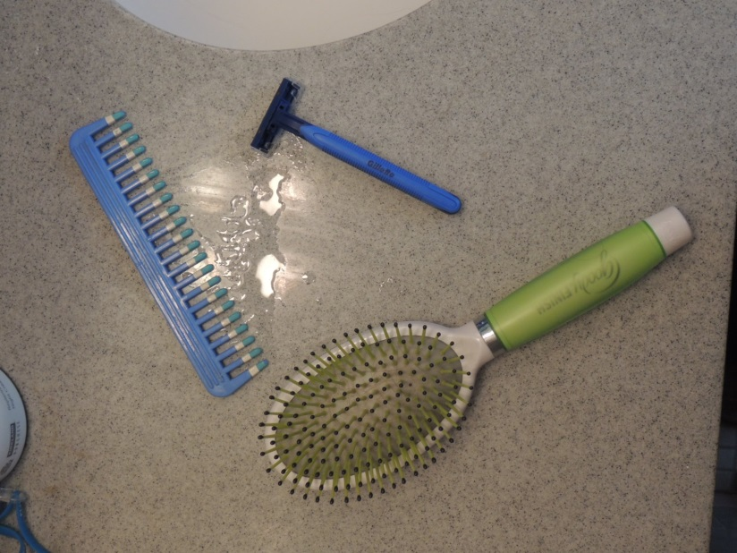
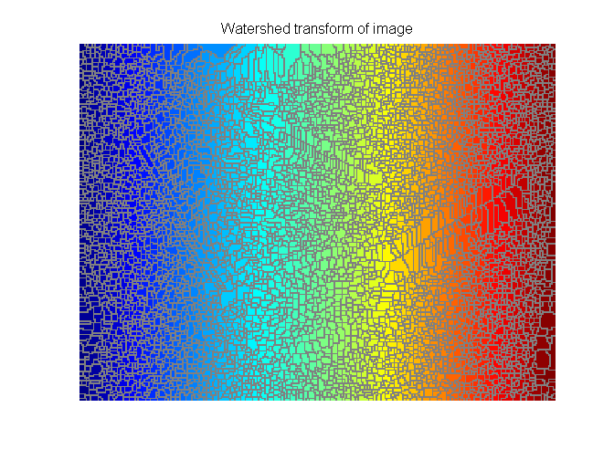
original
leads to over-segmentation
Superpixel segmentation

Slide 22
Using super-pixel segmentations
Object segmentation
Scene classification
Motion estimation
Depth estimation
Etc…

Slide 23
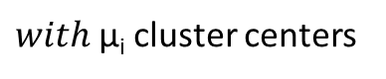
K-means clustering
Simple clustering: no explicit objective function, not guaranteed to give good results; greedy algorithm
K-means objective function:
Choose a fixed number of clusters
Algorithm (iterative)
fix cluster centers; allocate points to closest cluster
fix allocation; compute best cluster centers
x can be any set of features (be careful with scaling)
If x is only the feature (color, texture) -> segments not connected
reduce effect: include pixel coordinates as features
$with$μ_{i} cluster centers

Slide 24
K-means Algorithm
1. Initialize – Pick k random cluster centers
– Pick centers near data. Heuristics: uniform distribution in range of data; randomly select data points.
2. Assign each point to nearest center.
3. Compute new cluster centers as average of points assigned to it.
4. Go to step 2.

Slide 25
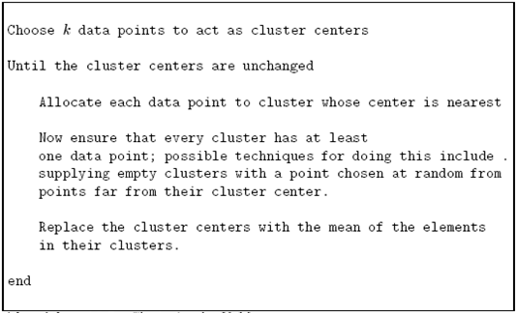
K-means clustering
Alg. 14.15 (Forsyth, Ponce)

Slide 26
K means continued
Will converge
But not to the global minimum of objective function
Variations: search for appropriate number of clusters by applying k-means with different k and comparing the results

Slide 27
Image Segmentation by K-Means
Select a value of K
Select a feature vector for every pixel (color, texture, position, or combination of these etc.)
Define a similarity measure between feature vectors (Usually Euclidean Distance).
Apply K-Means Algorithm.
Apply Connected Components Algorithm.
Merge any components of size less than some threshold to an adjacent component that is most similar to it.
* From Marc Pollefeys COMP 256 2003

Slide 28
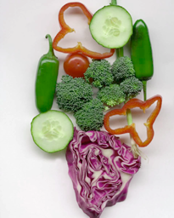
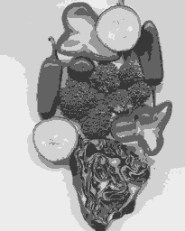
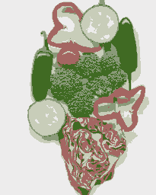
Results of K-Means Clustering:
Image
Clusters on intensity
Clusters on color
K-means clustering using intensity alone and color alone
* From Marc Pollefeys COMP 256 2003
Notes:
I gave each pixel the mean intensity or mean color of its cluster --- this is basically just vector quantizing the image intensities/colors. Notice that there is no requirement that clusters be spatially localized and they’re not.

Slide 29
Refinement
Use mixture of Gaussians; augment cluster centers with covariance matrix, which are re-estimated each step; amounts to Mahalanobis distance instead of nearest neighbors
With x_{i} data, μ_{i} cluster centers, Σ_{i} covariances
Probability distribution for x
We need to estimate the p_{k,} (the probability for distribution k), μ_{k} ,Σ_{k} and assignment value π_{k}

Slide 30
E M algorithm
Like K-means with soft assignment.
(vs hard assignment)
Assign point partly to all clusters based on probability it belongs to each.
Compute weighted averages (centers, and covariances)

Slide 31
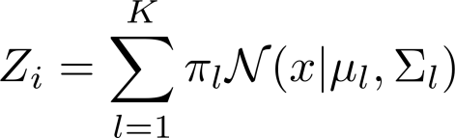
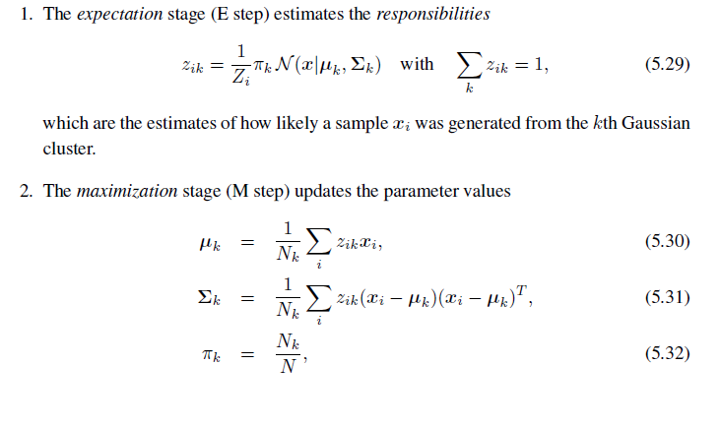
with
Probability for data point to come from each distribution
Estimates as weighted averages
From Szelisky (2010)

Slide 32
Mean Shift
Edge preserving smoothing
Followed by grouping
Idea: We model probability density function of some image function using a non-parametric model (no model parameters)
We find the peaks (mode) in the distribution, and iteratively move points in the direction of the peaks -> smoothing
(Fukunaga and Hostetler 1975; Cheng 1995; Comaniciu and Meer 2002)
Analysis of underlying optimization explains different mean shift formulations and smoothing techniques

Slide 33
Intuitive Description
Region of
interest
Center of
mass
Mean Shift
vector
Objective : Find the densest region
Some slides by: Yaron Ukrainitz & Bernard Sarel

Slide 34
Intuitive Description
Region of
interest
Center of
mass
Mean Shift
vector
Objective : Find the densest region
Distribution of identical billiard balls

Slide 35
Intuitive Description
Region of
interest
Center of
mass
Mean Shift
vector
Objective : Find the densest region
Distribution of identical billiard balls

Slide 36
Intuitive Description
Region of
interest
Center of
mass
Mean Shift
vector
Objective : Find the densest region
Distribution of identical billiard balls

Slide 37
Intuitive Description
Region of
interest
Center of
mass
Mean Shift
vector
Objective : Find the densest region
Distribution of identical billiard balls

Slide 38
Intuitive Description
Region of
interest
Center of
mass
Mean Shift
vector
Objective : Find the densest region
Distribution of identical billiard balls

Slide 39
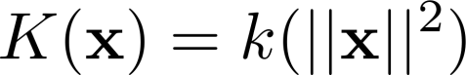
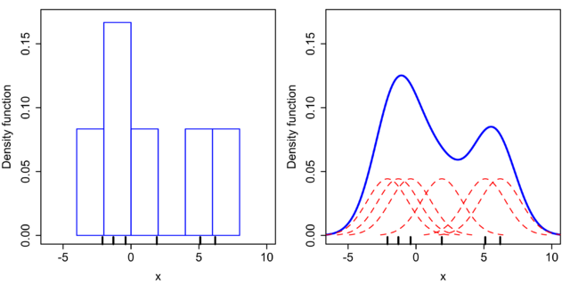
Kernel density estimation (Parzen window technique)
Approximating the pdf from sparse data {x_{i}}
K is kernel; k is profile; h is kernel width

Slide 40
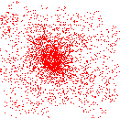
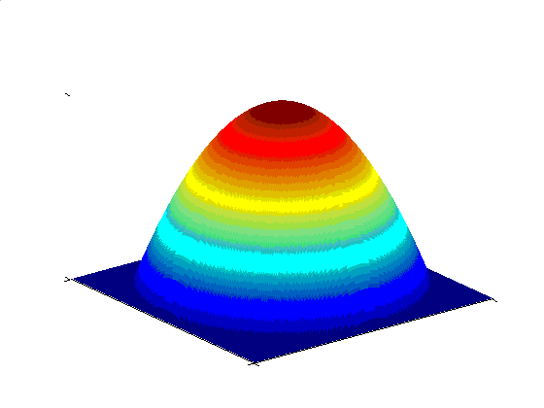
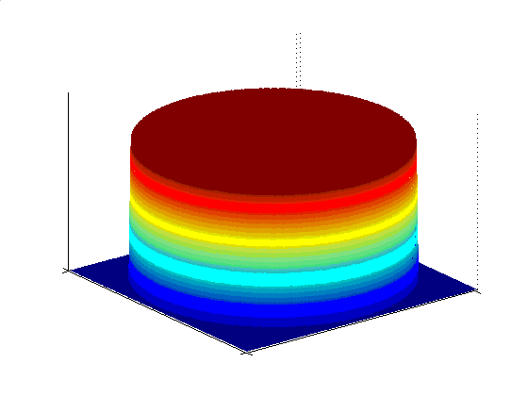
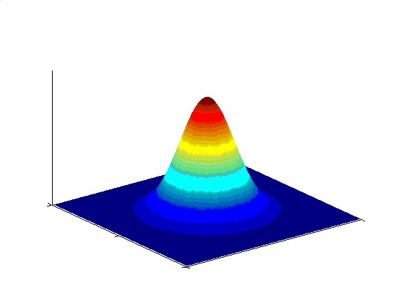
Kernel Density Estimation Various Kernels
A function of some finite number of data points
x₁…x_{n}
Examples:
Epanechnikov Kernel
Uniform Kernel
Normal Kernel
Data

Slide 41
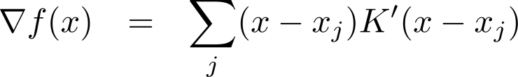
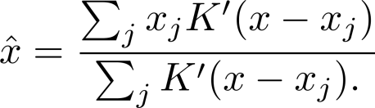
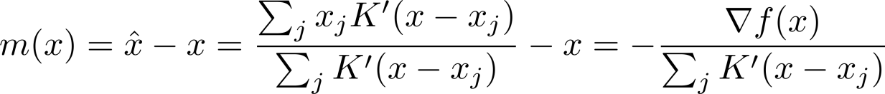
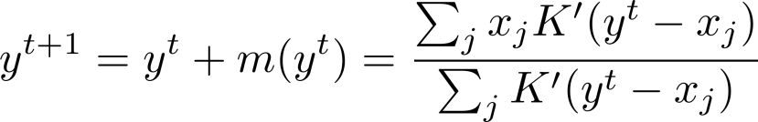
Theory
Gradient of kernel density estimate
Setting at the mode the gradient to zero, we obtain as estimate for the mode:
Thus the difference between $x$ and the estimate of the mode $\hat{x}$is:
which is called the mean shift, as it is difference between the weighted mean
of the neighbors x_{j} around x and the current value of x.
Mean shift procedure iteratively estimates the mode y as:

Slide 42
Clustering
Cluster : All data points in the attraction basin of a mode
Attraction basin : the region for which all trajectories lead to the same mode
Mean Shift : A robust Approach Toward Feature Space Analysis, by Comaniciu, Meer

Slide 43
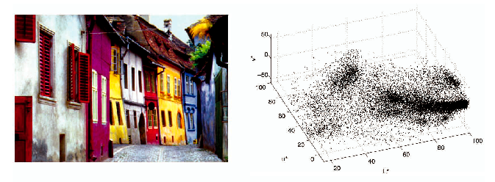
Clustering Real Example
L*u*v space representation

Slide 44
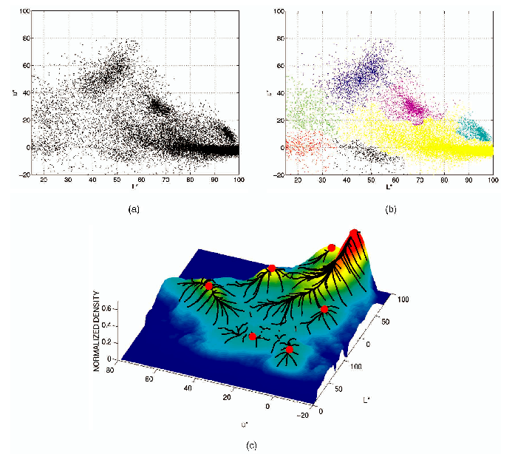
Clustering Real Example
2D (L*u) space representation
Final clusters
Not all trajectories
in the attraction basin
reach the same mode

Slide 45
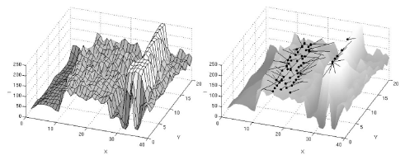
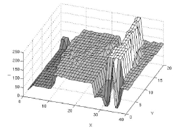
Discontinuity Preserving Smoothing
Feature space : Joint domain = spatial coordinates + color space
Meaning : treat the image as data points in the spatial and gray level domain
Image Data
(slice)
Mean Shift
vectors
Smoothing
result
Mean Shift : A robust Approach Toward Feature Space Analysis, by Comaniciu, Meer

Slide 46
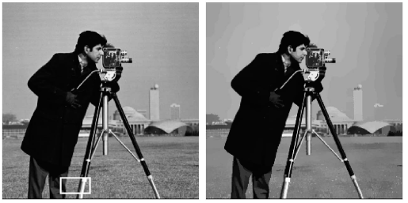
Discontinuity Preserving Smoothing Example

Slide 47
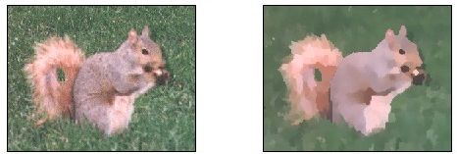
Discontinuity Preserving Smoothing Example

Slide 48
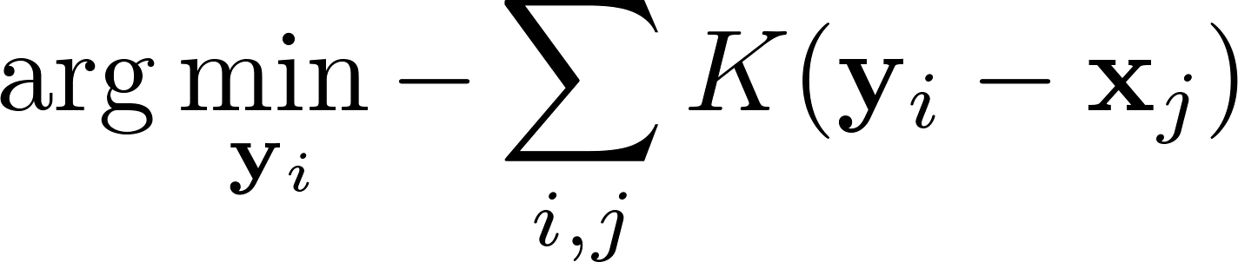
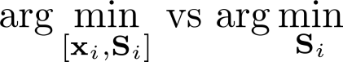
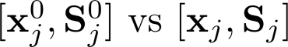
Mean shift as global optimization
Let {y_{i}} be the modes, mean shift can also be seen as gradient descent solution to
the optimization (Cheng, 1995)
Let y_{i} = [x_{i}, S_{i}] [image coordinate, color feature].
Then we can describe many methods depending on, whether
1.)
we optimize over [position and color] or color only
2.)
whether in the iteration we compare against the original value or the value from the last iteration

Slide 49
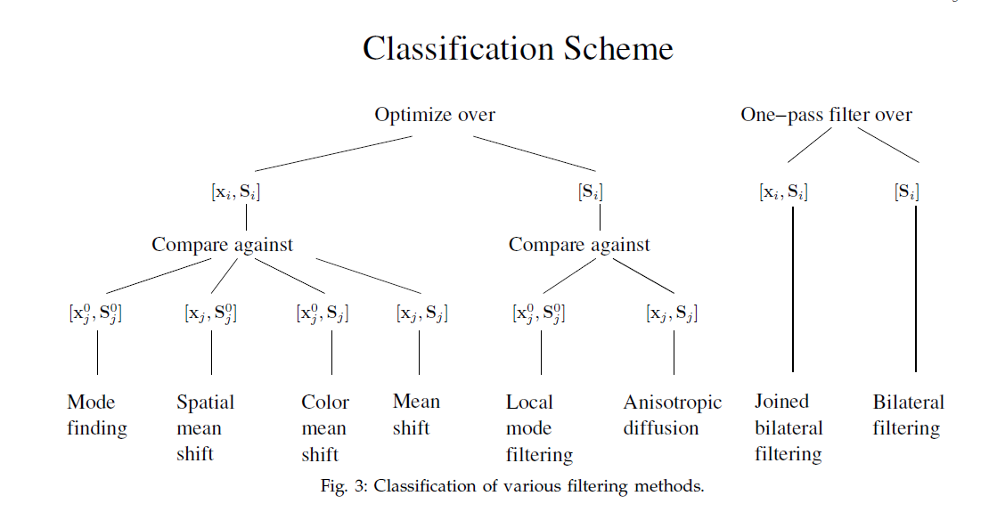
Analysis of underlying optimization explains relationship of different segmentation techniques and filtering methods (Bitsakos, Fermuller, Aloimonos , ECCV 2010)
Code available at: ……….
Weighted Gaussian smoothing with the weight determined by range difference and spatial difference
Comaniciu, Meer, 2002
Fukunage, Hostetler, 1975
Since points do not lie on regular grid
It is difficult to implemet

Slide 50
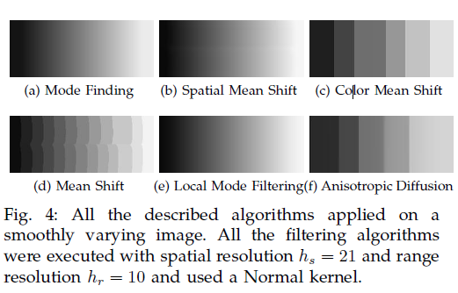

Slide 51
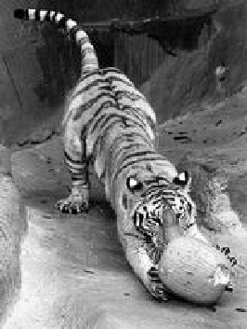
Images as graphs
i
w_{ij}
c
j
Fully-connected graph
node for every pixel
link between every pair of pixels, p,q
similarity w_{ij} for each link
Source: Seitz

Slide 52
Graph based segmentation Merging technique (Felzenszwalb and Huttenlocher, 2004)
Create a graph G = (V; E)
Each vertex v_{i} corresponds to a pixel
Edges e are between “neighboring” vertices
for example N8 neighbors
Weight on the edges
either intensity or color difference
5D distance (color, position)
C++ Code available (from Pedro Felzenswalb)
http://cs.brown.edu/~pff/segment/

Slide 53
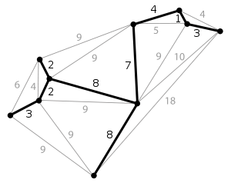
Distances
Internal difference of a region: Int(R)
largest edge weight in region’s minimum spanning tree
Minimum Spanning tree is a tree subgraph that connects all vertices with minimum weight
Difference between regions: Dif(R₁, R₂)
minimum weight on any edge connecting two regions
Merge two regions whose difference is lower than some Threshold
Threshold = minimum over the two regions: of internal difference + K/|R|

Slide 54
Algorithm
Create a graph with a vertex for every pixel
Sort edges by weight
Take each edge in turn
If the edge is between vertices in two different regions R₁ and R₂, merge if the edge weight is lower than the threshold
Merging regions in decreasing order of the edges separating them can be efficiently implemented using a variant of Kruskal’s minimum spanning tree algorithm
For fixed size neighborhood O(N log N) with N pixel number

Slide 55
Parameters
σ: Gaussian smoothing (preprocessing the image to reduce noise)
K: threshold value for doing the clustering,
sets scale, larger k -> larger clusters
min parameter: the smallest cluster size must contain at least this many vertices – clusters that are too small will be merged with other clusters until sufficiently large
If clustering in feature space: define neighborhood size

Slide 56
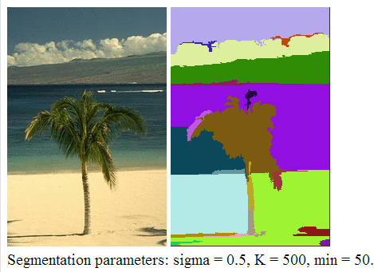

Results
Results from Felzenswalb’s site
More results from : Warren Cheung

Slide 57


Increasing σ
Clouds are recognised as one object
Palm tree gets confused with ocean

Slide 58


Grain
Increasing σ introduces more blurring (reduces the edge weight between pixels)

Slide 59

Increasing Threshold
Clusters more aggresively
Palm tree is confused with ocean and clouds

Slide 60

Grain
Non-grain pixels are almost all clustered together
Measure of how “similar” all the pixels of an object should be

Slide 61

Increasing ‘min’ value
Segmentation is the same, but small components are merged with neighboring ones

Slide 62

Grain
Easy to control change, gets rid of small artifacts

Slide 63
Segmentation as Graph Partitioning
Each pixel in the image is a node in the graph
Arcs represent similarities between adjacent pixels
Fully connected graph
Represent affinity in graph as weight matrix
Directed and undirected graphs, weighted graphs
For an undirected graph, we use a symmetric matrix and place half the weight in
each of the i, j’th and j, i’th element.

Slide 64

Representation of undirected graph my a symmetric matrix

Slide 65


Similarity matrix
Scale affects affinity
affinity by distance:
Larger σ_{d :} distant
points will be grouped,
Smaller σ_{d:} only nearby
points will be grouped
Increasing sigma

Slide 66
Segmentation by Graph Cuts
w
A
B
C
Break Graph into Segments
Delete links that cross between segments
Easiest to break links that have low cost (low similarity)
similar pixels should be in the same segments
dissimilar pixels should be in different segments
Source: Seitz

Slide 67

Cuts in a graph
B
A
Link Cut
set of links whose removal makes a graph disconnected
cost of a cut:
Find minimum cut in graph : Min cut
gives you a segmentation
fast algorithms exist for doing this
Source: Seitz

Slide 68

But min cut is not always the best cut...
Problem: Cost of cut proportional to number of edges in the cut -> tends to produce small, isolated components

Slide 69
Cuts in a graph
B
A
Normalized Cut (Shi and Malik, 2000)
a cut penalizes large segments
fix by normalizing for size of segments
assoc(A,V) = sum of costs of all edges that touch A
Approximate solution for minimizing Ncut value: generalized eigenvalue problem

Slide 70


Idea: Linear algebra solution
For simpler problem: minimize cut(A,B)
a_{n} is a vector representing the association of each each element to the n^{th} cluster;
A association matrix
We obtain
which we differentiate to obtain
Data points
Points defined by eigenvector

Slide 71



Modified minimization
Introduce degree matrix
y is vector of elements, whose values are either 1 or -b
Obtain real vector as
Smallest eigenvalue is zero, so we obtain second smallest eigenvalue.

Slide 72
Recursive normalized cuts (with modified criterion for normalized cut)
Given an image or image sequence, set up a weighted graph: G=(V, E)
Vertex for each pixel
Edge weight for nearby pairs of pixels
Solve for eigenvectors with the smallest eigenvalues: (D − A)y = λDy
Use the eigenvector with the second smallest eigenvalue to bipartition the graph
Note: this is an approximation
Recursively repartition the segmented parts if necessary
So-called spectral clustering technique, because it uses the spectrum (eigenvalues) of the similarity matrix of the data to perform dimensionality reduction before clustering
http://www.cs.berkeley.edu/~malik/papers/SM-ncut.pdf
Details:

Slide 73

Normalized cuts results

Slide 74

Normalized cuts: Pros and con
Pros
Generic framework, can be used with many different features and affinity formulations
Provides regular segments
Cons
Need to chose number of segments
High storage requirement and time complexity
Bias towards partitioning into equal segments
Usage
Use for oversegmentation when you want regular segments

Slide 75


Segmentation as Energy minimization
Formulate segmentation as labeling problem. Find the labels f_{p} of each pixel such that the objective function is minimized
Other labeling problems (stereo, denoising, foreground-background segmentation)
Data term
Unary term
Smoothness term
Binary term

Slide 76


Markov Random Field formulation
The idea:
MAP estimation: Taking the negative logarithm
Which can be thought of as energy
Data term
For MRFs p(f) is a Gibbs distribution and (according to the Hammersley–Clifford theorem:
The sum over the cliques

Slide 77

Markov Random Fields
Unary potential
Example: “label smoothing” grid
0: -logP(f_{i} = 0 ; data)
1: -logP(f_{i} = 1 ; data)
Node f_{i}: pixel label
Pairwise Potential
0 1
0 0 K
1 K 0
Edge: constraint on pairs

Slide 78
Graph Cuts for Segmentation
• Seek division of image into foreground and
background.
• Turn image into graph, each pixel connected to
neighbors and special source (foreground nodes ) and sink (background nodes).
• A cut of the graph divides it into foreground and
background.
• Edge weights determine:
– Is a pixel likely to be foreground or background?
– Is a pixel likely to have same label as neighbors?

Slide 79
Solving MRFs with graph cuts
Source (Label 0)
Edge weights: Cost to assign to 0
Cost to split nodes
Cost to assign to 1
Sink (Label 1)
Source and Sink connect to all nodes

Slide 80
Solving MRFs with graph cuts
Remove edges so there is no path from source to sink.
Weight of cut is the sum of the weight of edges removed.
Source (Label 0)
Cost to assign to 0
Cost to split nodes
Cost to assign to 1
Sink (Label 1)
Minimum cost to cut can be formulated as max flow in flow network (graph theory)
and solved efficiently.
(Boykov, Kolmogorov 2004)

Slide 81
Terms
Color histogram for data term:
Compute normalized color histograms for foreground and background, Find Pr(p|Foreground), Pr(p|Background) by finding to which bin p belongs to, and looking up values in normalized histograms.
w(p,S) = -log(Pr(p|Background))
w(p,T) = -log(Pr(p|Foreground))
Why- log?
We are adding weights. We multiply probabilities, so add log
To maximize probabilities; so minimize negative log
Or Gaussian mixture model for intensity/color model

Slide 82

Terms
Hard constraints (in interactive settings):
If pixel p definitely is foreground, make:
w(p,S) very big, w(p,T) = 0.
Smoothness term often
(normalized gradient)

Slide 83



Results
Full segmentation
User Input No Edge Weights
Just Data Term
From D. Jacobs

Slide 84



Grabcut
“GrabCut” — Interactive Foreground Extraction using Iterated Graph Cuts
(Rother, Kolmogorov, and Blake, 2005)

Slide 85




Colour Model
Foreground & Background
Iterated graph cut
Gaussian Mixture Model (typically 5-8 components)
Source: Rother

Slide 86


Interactive segmentation
Mark foreground and background pixels
Boykov, Jolly, (2004)

Slide 87

Using graph cuts for recognition
TextonBoost (Shotton et al. 2009 IJCV)

Slide 88
Limits of graph cuts
Must satisfy
Associative: edge potentials penalize different labels
If not associative, can sometimes clip potentials
Approximate for multilabel
Alpha-expansion or alpha-beta swaps (Boykov, Veksler, Zabih, 2011)
Basic idea
reduce to a series of 2-way-cut sub-problems, using one of:
swap move: pixels with label l1 can change to l2, and vice-versa
expansion move: any pixel can change it’s label to l1

Slide 89
Graph cuts: Pros and Cons
Pros
Very fast inference
Can incorporate recognition or high-level priors
Many extensions using priors (e.g. shape)
Applies to a wide range of problems (stereo, image labeling, recognition)
Cons
Not always applicable (associative only)
Need unary terms (not used for generic segmentation)
Bias toward small segments (because the total energy is sum of weights)

Slide 90

Fixation based segmentation with graphcut

Slide 91
Segment what you look at

Slide 92
Segment what we look at
Human visual system attends to an object by fixating on it.
A lot of work done (visual attention literature)
What happens as we fixate?
Segment the fixated object (or region)
Possible issues:
Scale
Texture

Slide 93
We want contours at different distance from the fixation point to require the same weight to cut.
Example: Internal contour length: 100 pixels
Outside contour length: 400 pixels
Smaller (dimmer) contour costs less to cut

Slide 94




Solution: polarspace
Log-polar coordinate system

Slide 95





Fixation-based Algorithm
Cartesian to Polar Conversion
Probabilistic Boundary Map
Optimal Cut separating
inside from outside
Notes:
95

Slide 96
Graph Cut formulation
Assign label ‘0’ to all nodes in first column, as it represents the fixation point itself, (r=0, theta)
Similarly, assign label ‘1’ to all nodes in the last column, as it is the outer most circle around the fixation point
Cut
Notes:
96

Slide 97
Graph Cut formulation
For edge segmentation only U is only initialized in the first and last row
First col: U(l_{p}=1) =D, U(l_{p}=0) = 0; Last col. U(l_{p}=0) =0, U(l_{p}=1) =D
if
Every pixel in the polar map is a vertex,i, in graph G.
A set of labels for G:
Minimize
Notes:
97

Slide 98
Multi-step algorithm
First segment using only edges
Second, the segmentation results of previous step is used to generate color distributions for inside F_{in}(.)and outside F_{out}(.)
Combine the edge information (binary terms) with color distribution (unary terms) in a graph cut framework to segment inside from outside.
Notes:
98

Slide 99

Results using region+boundary
Edge alone
Edge + color distribution
Notes:
99

Slide 100


Edges and color only
Notes:
100

Slide 101


Combining Cues
Disparity Map
Depth Boundary
Notes:
101

Slide 102



Combining Cues
Notes:
102

Slide 103

Combining Cues
Notes:
103

Slide 104





Slide 105
RGB-Depth images

Slide 106
Motion

Slide 107

Using edges, color, texture and depth
Ajay Mishra : http://www.umiacs.umd.edu/~mishraka/
Mishra, Aloimonos, Cheong and Kassim, PAMI 2012

Slide 108

Weighting

Slide 109





Weighting
We weight the binary terms in Cartesian coordinate system to simulate a polar coordinate system:
Cartesian - Logpolar
Weight is distance between points:
Using the transformation between differentials:
Distance between two neighboring points
for N4 always 1
We obtain
Just divide binary term by r

Slide 110

Segmentation with shadow removal
Ecins, Fermüller, Aloimonos, 2013

Slide 111
Resources on graphcut
Olga Veksler: efficient graphcut implementation http://www.csd.uwo.ca/~olga/code.html
Matlab wraper: http://vision.ucla.edu/~brian/gcmex.html
Our log-polar minimization: code

